Slide 1
CEMD Data Analyst Performance Task
Adam Erler

Slide 2
Data As Code
All of the analysis can be found in the jupyter notebook at this github repo:
https://github.com/aerler101-1/CEMD/blob/main/CEMD.ipynb
A visual tool for exploring the data can be found here:
https://cemdperf.streamlit.app/
Notes:
The initial EDA and Analysis is executed in a jupyter notebook for readability and transparency. The primary language used for the project is Python and some light markdown for ad hoc thoughts. The visual created is also using Python for the heavy lifting. The purpose of the visual would be a conversation piece with the CAO. A place to discuss what views are useful, what other questions do these pictures dredge up? These graphs are answers but what would we need to know to get here?

Slide 3
Exploratory Data Analysis (EDA)
.
The ID columns were named inconsistently
Not all Student IDs were present in all tables
Schools A and B serve different grade levels
Some students change teachers mid year
For simple analysis a wide table will be the most succinct
Notes:
The first step was understand holistically and contextually the data available. Creating a view of what information was stored in these 4 sheets and how they connected was the purpose of the initial EDA. The findings were these points…
The final table for the visual and analysis will only use overlapping student IDs. This way we can ensure we are comparing apples to apples and not partially incomplete datasets.

Slide 4
Validation Checks
Executed:
Percentages of tardiness and absence
School mismatch between files
Teachers with multiple sections
Duplicate rows
Validity of anticipated index
Future Checks:
Student grade level consistency
Student grade promotion
External target validation
Population of null values
Notes:
As a result of the combined EDA and idiosyncrasies during the analysis, the following validation checks were applied. In a full stack project these would have been brain stormed and completed in more thorough approach. The validation checks are split into checks that are present and checks needed for future consideration. For the future checks collaborating with the provided for the exams would be a necessary step. Ensuring the targets and such percentiles are consistent with nation data. Also there are null values for teachers and missing tests. It may be possible with more exploration to recover missing data points.

Slide 5
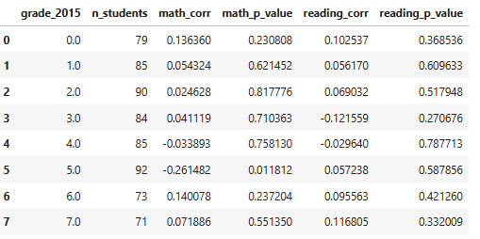
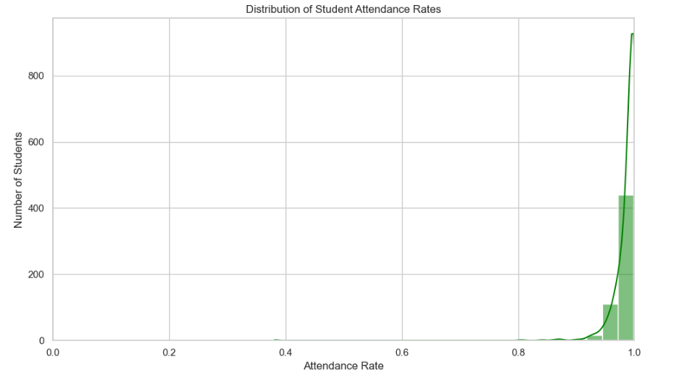
Attendance
Data correction: EventDate collapsed
Does Chronic Absenteeism show a strong correlation for MAP performance?
Notes:
EventDate was malformed and had repeated rows. These were collapsed to single rows when possible. This problem was initially found when some students had attendance rates that exceeded 100% since that is not a reasonable value a deeper dive into a few failed examples revealed the issue.
The table shown here is the correlation and p values for those comparisons. With such low correlation values and high p values, the initial interpretation is that absenteeism cannot be shown to have a strong impact on fall to fall performance. The small sample size by grade could be a contributing factor, but in current PDs I would not feel comfortable using this lever as one of action for test improvement.
Tardiness has a similar outcome.

Slide 6
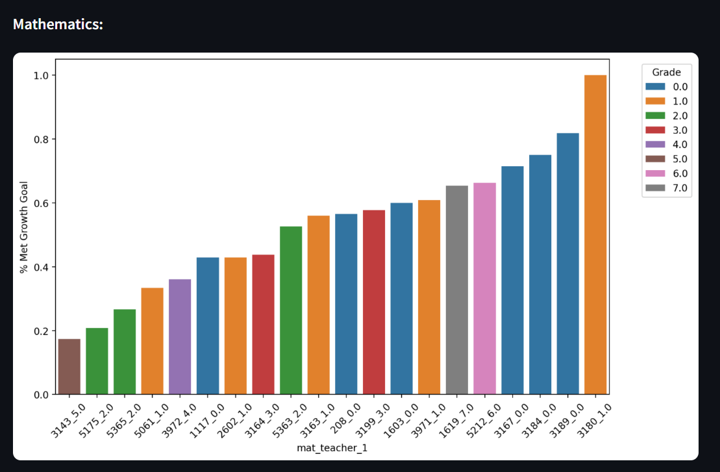
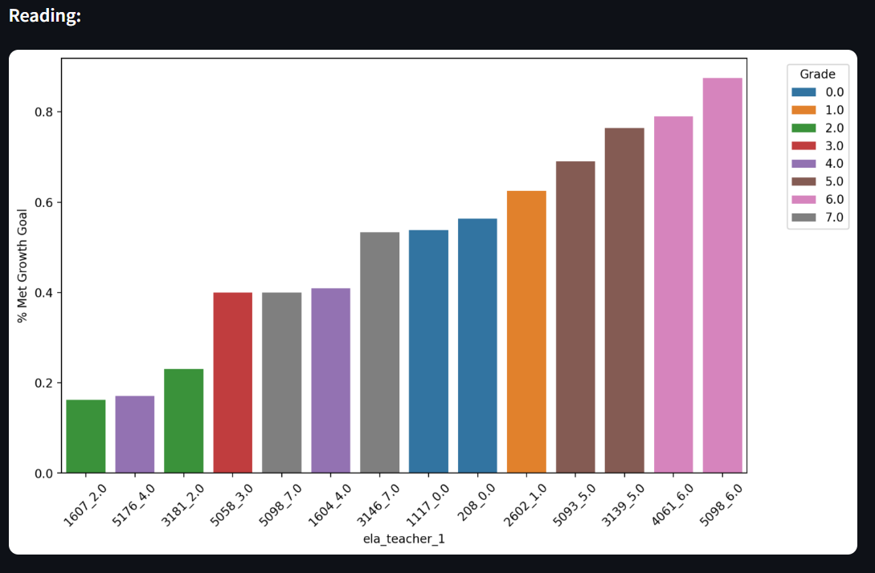
Teacher Effectiveness
Is it obvious that students assigned to certain teachers were more likely meet their “Fall-to-Fall” MAP Reading or Math goals?
Notes:
There were a few things to note when it came to teachers being connected to students. First, some students had multiple teachers for the same grade and subject in 2015. It was assumed the first teacher was their fall teacher for the test of record. This would be a question for our CAO, if there was a record of how much time students spent with each teacher. It would assist in correctly attaching student performance to their teachers. Also some teachers in lower grades taught both math and ela sections. A more thorough overview of if these student sections overlapped would be part of a larger project. To the extent of the question being asked. The answer is not obvious but some trends do present themselves. Grand bands appear to perform similarly by subject. There are some outliers in teacher success, and these may be worth exploring to get a view of these teachers best practices. Teachers are only have their percentages calculate for students with non null ftf targets.

Slide 7
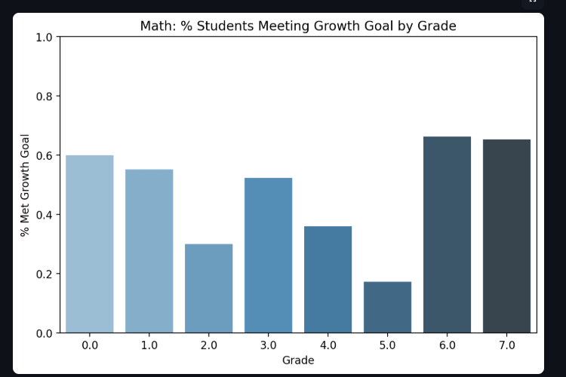
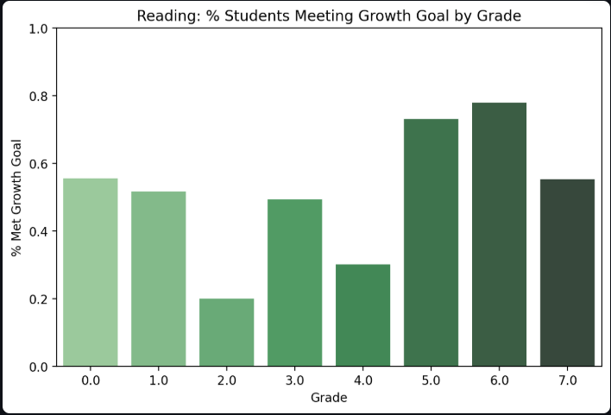
Grade Level Breakdown
There are some key transitions that are proving difficult for students.
Notes:
While viewing successful teachers can be a strong way to help identify best practices, it is clear with the fall to fall metrics that some students are having trouble in particular grades. Encouraging teachers across these low performing grade bands to collaborate and create grade level transition plans could be fruitful.

Slide 8
Next Steps Data Analyst
Expand growth relationships
Quartiles
CAO Feedback
Data Integrity
Notes:
Creating metrics for all of the testing pairs and possible creating longitudinal charts by teacher for students.
Quartiles are present in the data but that would be a fruitful next steps in analysis.
This initial mockup shows that the while the two questions the CAO led with were meaningful, there is much more information to gather here. A walk through of the current project and feedback from the stakeholders would be appropriate at this point.
There were some pretty serious inconsistencies in the data with this first pass. For example, the duplicate rows in attendance. With attendance being such a critical role, it is possible more inconsistencies remain to be found. A full conversation with team members about points of data integrity would be a useful internal step.
This project is a baseline for conversations. I expedited certain steps to provide a full view of a project stack but would expect a project of this caliber to require closed to a full work week + time for stakeholder conversations.

Slide 9
Self Explore and Professional Development
https://cemdperf.streamlit.app/ Visual Aid
Goals
Best Practices
Notes:
Following up on the DA next steps the CAO next steps would be conversations with department heads. What will the teachers find useful? What questions do they have? Show them the visual, does this provoke concerns, wants or needs? From this we can highlight which teachers are currently the most effective. This could be a useful lever for immediate action. This does lay the groundwork for grade level teams to collaborate and ensure these transitions are consistent each yet.

